Slide 1

YouTube Advertisement Putting
Yuqing Wu

Slide 2

01 Introduction & Business Objective
Content
02 EDA
03 Model
04 Result
05 Q&A

Slide 3

01 Intro & Business Objective
Objective:
Analyze YouTube video clicks to determine which videos to advertise for, thereby increasing potential users and sales, and increasing revenue.

Slide 4
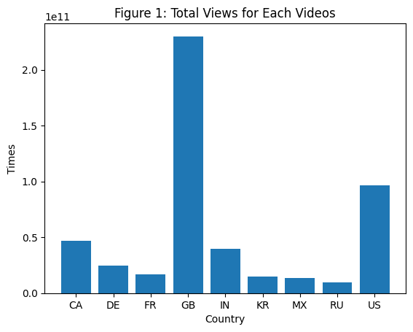

02 EDA:
Total Views for Each Videos
GB videos get the highest views.
The higher the views, the more potential customers will see our products -> higher profits

Slide 5

02 EDA:
Total Views By Year and Month
Year | Month | Views
2017 | 11 | 29380703627
2017 | 12 | 62170362364
2018 | 1 | 50926682582
2018 | 2 | 92758978148
2018 | 3 | 145268141031
2018 | 4 | 108011482194
2018 | 5 | 168840478255
2018 | 6 | 66047626878
May is the month with the highest number of views -> we should put advertisement on May

